Slide 1
KELP
Project Apex
Investment Opportunity
Strictly Private & Confidential – Prepared by Kelp M&A Team

Slide 2
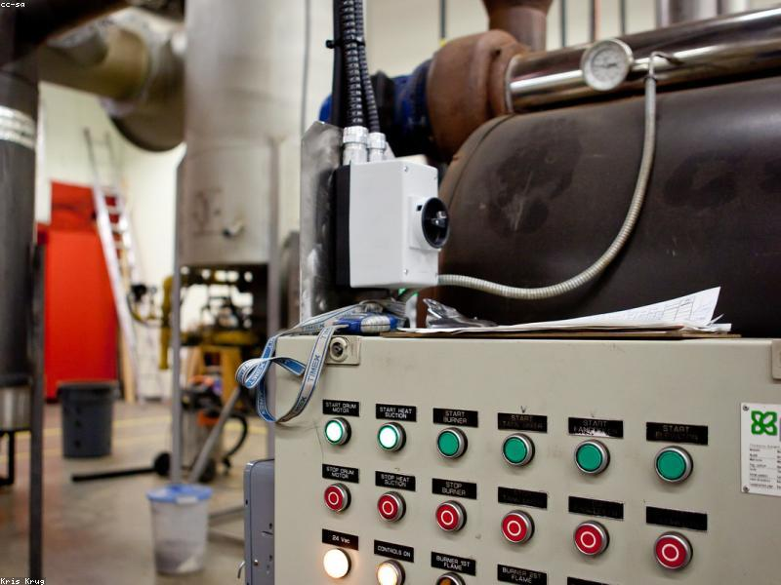
KELP
BUSINESS PROFILE & INFRASTRUCTURE
■ The company operates in the steel manufacturing sector.
■ It has a production capacity of 1.2 million tonnes per annum.
■ certifications include ISO9001 and OHSAS 18001 certification standards.
■ The company serves the automotive, construction, and energy industries.
■ Headquarters are located in Chennai, India.
Strictly Private & Confidential – Prepared by Kelp M&A Team

Slide 3
KELP
FINANCIAL & OPERATIONAL SCALE
■ Revenue for 2025: $1.3 billion.
■ EBITDA margin in 2025 was reported at 4%.
Strictly Private & Confidential – Prepared by Kelp M&A Team

Slide 4

KELP
INVESTMENT HIGHLIGHTS
■ The company secured a contract worth $20 million for the next 5 years.
■ An order book of steel products valued at $1.8 billion is currently pending with customers.
Strictly Private & Confidential – Prepared by Kelp M&A Team

Slide 5
Disclaimer
This presentation is strictly confidential and is being provided to you solely for your information. By accepting this presentation, you agree to keep it confidential and not to distribute it to any other person.
This document does not constitute an offer to sell or a solicitation of an offer to buy any securities. The information contained herein has been obtained from sources believed to be reliable but is not guaranteed as to accuracy or completeness. Project Apex and Kelp M&A Team make no representation or warranty regarding the accuracy of the information.
This presentation may contain forward-looking statements that involve risks and uncertainties. Actual results may differ materially from those projected.
Strictly Private & Confidential – Prepared by Kelp M&A Team

